Slide 1
Introduction to Relational Model

Slide 2
Relational Model
Primary data model for commercial data processing applications.
Consists of relational databases
Advantages:
Simplicity
Eases the job of the programmer

Slide 3
Structure of Relational Databases
Relational database → collection of tables with unique names
Tables → relations
Rows of the table → records or tuples
A row in a table represents a relationship among a set of values
Set of similar records or tuples forms a relation
Columns of the table → attributes or fields

Slide 4
Contd..
Set of permitted values of the attributes → domain values
A domain is atomic if elements of the domain are considered to be indivisible units.
Null value → special value that signifies that the value is unknown or does not exist

Slide 5
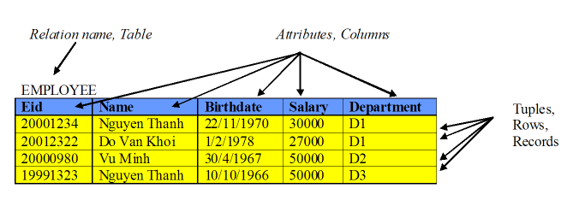
Example

Slide 6
Database Schema and Instance
Database schema:
Logical design or overall design of the database
Does not change frequently
Eg: university (instructor, student)
Database instance:
Snapshot of the data in the database at a given instant in time.
Changes frequently

Slide 7
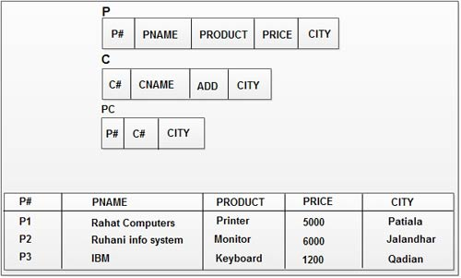
Example

Slide 8
Relation Schema and Instance
Relation schema:
Consists of a list of attributes and their corresponding domains.
Similar to a variable in programming language.
Does not change frequently
Eg: instructor = (ID, name, dept_name, salary)
Relation instance:
Set of domain values in a relation at a particular point of time or current values
Similar to type definition in programming language
Changes frequently

Slide 9
Codd’s rules,
Dr Edgar F. Codd, after his extensive research on the Relational Model of database systems, came up with twelve rules of his own, which according to him, a database must obey in order to be regarded as a true relational database.
These rules can be applied on any database system that manages stored data using only its relational capabilities. This is a foundation rule, which acts as a base for all the other rules.
Often referred to as rule 0, this rule states that all subsequent rules are based on the notion that in order for a database to be considered relational, it must use its relational facilities exclusively to manage the database.

Slide 10
Rule 1: Information Rule
The data stored in a database, may it be user data or metadata, must be a value of some table cell. Everything in a database must be stored in a table format.
Rule 2: Guaranteed Access Rule
Each unique piece of data(atomic value) should be accessible by : Table Name + Primary Key(Row) + Attribute(column).
NOTE: Ability to directly access via POINTER is a violation of this rule
Rule 3: Systematic Treatment of NULL Values
The NULL values in a database must be given a systematic and uniform treatment. This is a very important rule because a NULL can be interpreted as one the following − data is missing, data is not known, or data is not applicable.

Slide 11
Rule 4: Active Online Catalog
Database dictionary(catalog) is the structure description of the complete Database and it must be stored online. The Catalog must be governed by same rules as rest of the database. The same query language should be used on catalog as used to query database.
Rule 5: Powerful and Well-Structured Language
One well structured language must be there to provide all manners of access to the data stored in the database. Example: SQL, etc. If the database allows access to the data without the use of this language, then that is a violation
Rule 6: View Updating Rule
All the views of a database, which can theoretically be updated, must also be updatable by the system.
Different views created for various purposes should be automatically updatable by the system.

Slide 12
Rule 7: High-Level Insert, Update, and Delete Rule
A database must support high-level insertion, updation, and deletion. This must not be limited to a single row, that is, it must also support union, intersection and minus operations to yield sets of data records.
Rule 8: Physical Data Independence
Any modification in the physical location of a table should not enforce modification at application level.
Rule 9: Logical Data Independence
Any modification in logical or conceptual schema of a table should not enforce modification at application level. For example, merging of two tables into one should not affect application accessing it which is difficult to achieve.

Slide 13
Rule 10: Integrity Independence
Integrity constraints modified at database level should not enforce modification at application level.
Rule 11: Distribution Independence
The end-user must not be able to see that the data is distributed over various locations. Users should always get the impression that the data is located at one site only. This rule has been regarded as the foundation of distributed database systems.
Rule 12: Non-Subversion Rule
Low level access to data should not be able to bypass integrity rule to change data.

Slide 14
Keys
Types of keys:
Super key
Candidate key
Primary key
Foreign key
Composite Key

Slide 15
Super Key
A super key is a set of attributes of any combination that uniquely identifies a record within a table.
Given table:
STUDENT{StudentId, firstName, lastName, courseId}
Possible superkeys are:
{StudentId}
{StudentId, firstName}
{firstName, lastName}
(StudentId, firstName, lastName, courseId}

Slide 16
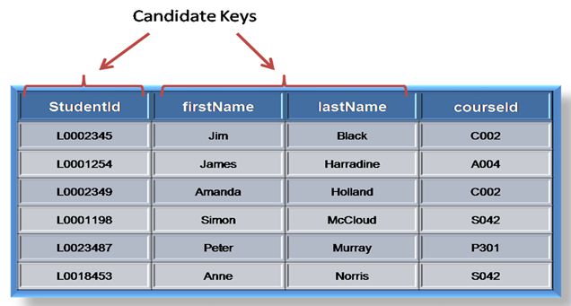
Candidate Key
Subset of super key
Minimal super key
Single field or least combination of fields that uniquely identifies each record in the table

Slide 17
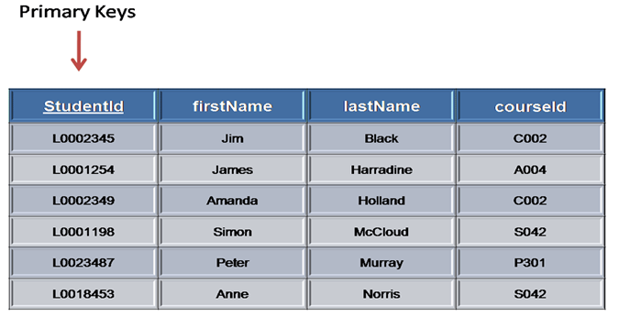
Primary Key
Main reference key of the table
One of the candidate keys that is most appropriate to uniquely identify a record in a table.

Slide 18
Foreign key
Used to relate two tables
Non-primary key of one table (child table) acts as a primary key for another table (parent table) in order to provide relationship between these two tables.
That non-primary key attribute is said to be the foreign key for CHILD TABLE.
Child table is called as the referenced relation and the parent table is called as the referencing relation

Slide 19
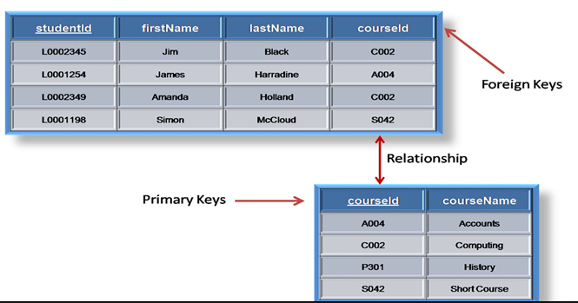
Example

Slide 20
Composite Key
Key that consists of two or more attributes that uniquely identify any record in a table is called Composite key.
But the attributes which together form the Composite key are not a key independentely or individually.
Any key such as super key, primary key, candidate key etc. can be called composite key if it has more than one attributes.

Slide 21
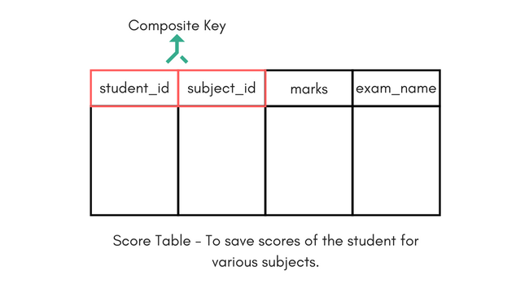
In the above picture we have a Score table which stores the marks scored by a student in a particular subject.
In this table student_id and subject_id together will form the primary key, hence it is a composite key.

Slide 22
INTEGRITY CONSTRAINTS
Definition:
Constraints is a specific rules or limits that we define our table.
An integrity constraint is a mechanism to prevent invalid data entry into the table.
A. Domain Integrity Constraints:
It verifies whether the data entered is in proper form and also they set a range for the input data.

Slide 23
Domain Integrity Constraints:
i. Not Null Constraints: The enforcement of Not null constraints in a table makes the user to enter a value in the field.
Syntax:create table tablename (columnname1 datatype not null, columnname2 datatype, columnname3 datatype, ....);
ii. Check Constraints: It allows only a particular range of values defined in the constraints.
Syntax: create table tablename (columnname1 datatype,
columnname2 datatype, ...., check(condition);

Slide 24
B. Entity Integrity Constraints:
Entity integrity constraints are used to enforce consistency in the database. There are two types of entity integrity constraints.

Slide 25
B. Entity Integrity Constraints:
i. Unique Constraints: It is used to prevent duplication of data in a column or a group of columns in a table. It allows the null values.
Syntax: create table tablename (columnname1 datatype unique, columnname2 datatype, ....);
ii. Primary key Constraints: It is used to prevent duplication of data in a column or a group of columns in a table. It does not allows the null values.
Syntax: create table tablename (columnname1 datatype primary key, columnname2 datatype, …);

Slide 26
Referential Integrity Constraints
Set of constraints applied to foreign key which prevents entering a row in child table (where you have foreign key) for which you don't have any corresponding row in parent table.
Referential Integrity prevents your table from having incorrect or incomplete relationship.

Slide 27
C. Referential Integrity Constraints:
Referential integrity constraints enforce relationship between tables. The foreign key establishes a column or a combination of columns as a foreign key. It establishes a relationship with the a specified primary or unique key in another table, called the referenced key
CREATE TABLE Orders (
OrderID int NOT NULL PRIMARY KEY,
OrderNumber int NOT NULL,
PersonID int FOREIGN KEY REFERENCES Persons(PersonID)
);

